Slide 1
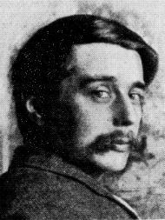
“
Civilization is in a race between education and catastrophe.
Let us learn the truth and spread it as far and wide as our circumstances allow. For the truth is the greatest weapon we have.
~H.G. Wells
Notes:
We have the big picture now
My aim is to tell a story that sounds true for everyone

Slide 2
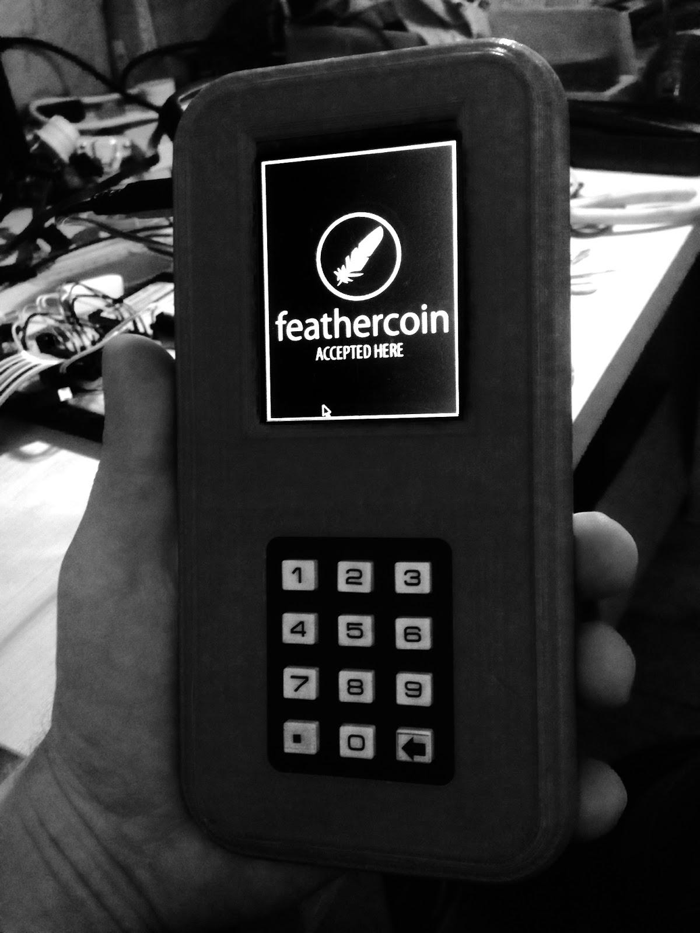
Feathercoin Point of Sale
Notes:
The case is made from a 3D printer, inside it’s a Raspberry Pi

Slide 3
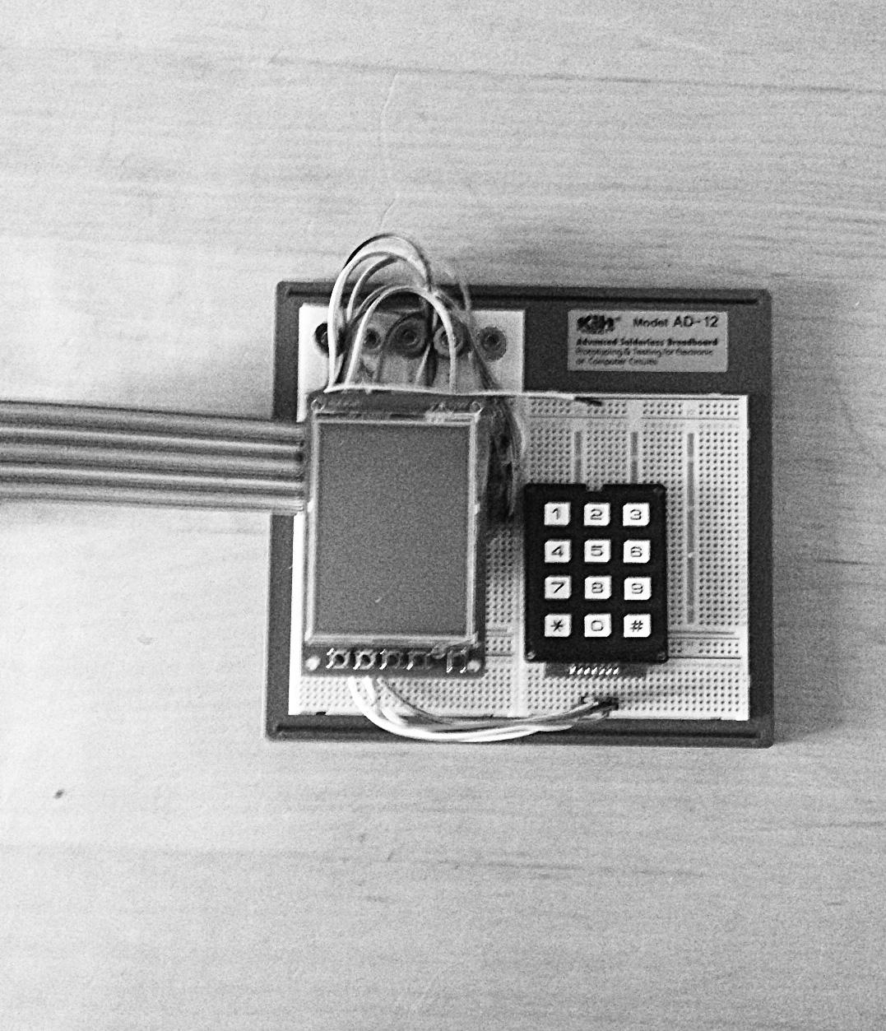
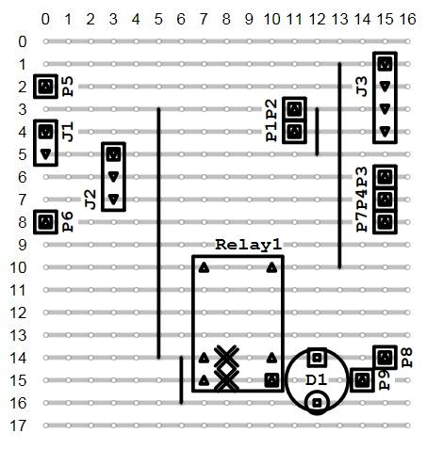
Hardware is Open Source

Slide 4
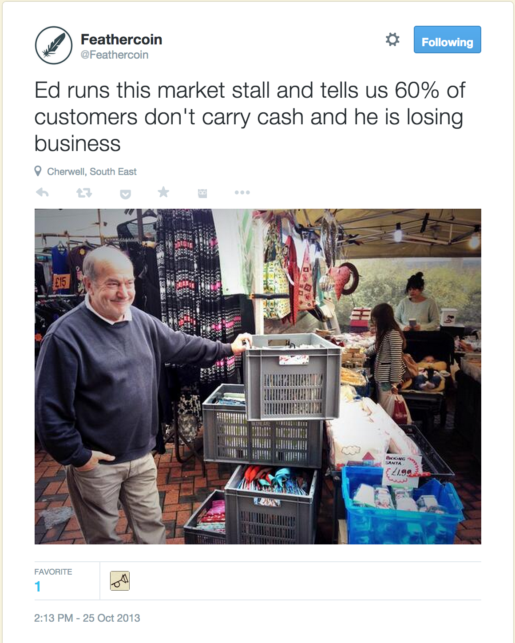
What I have learned so far:
‘Money’ was already digital
But it’s not the money we want,
it’s each other;
where it takes us;
and who is helps us become
Helping one another have impact
Helping one another stay relevant
Help me make my contribution
Notes:
Money was digital long before Bitcoin came along
David Chaum was working on it as early as 1981
But I realised it wasn’t the money people wanted

Slide 5
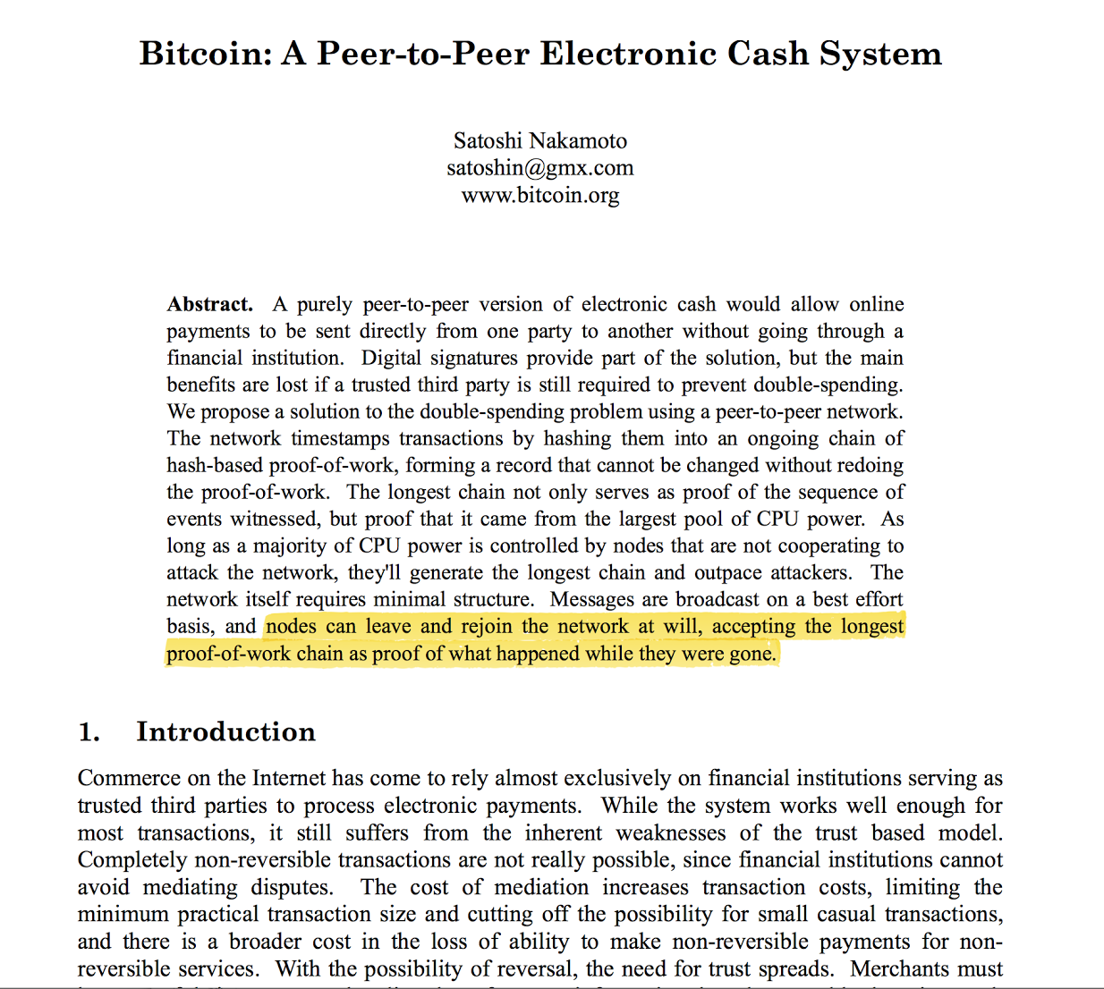
Notes:
“Nodes can leave and rejoin the network at will, accepting the longest proof-of-work chain as proof of what happened while they were gone.”

Slide 6
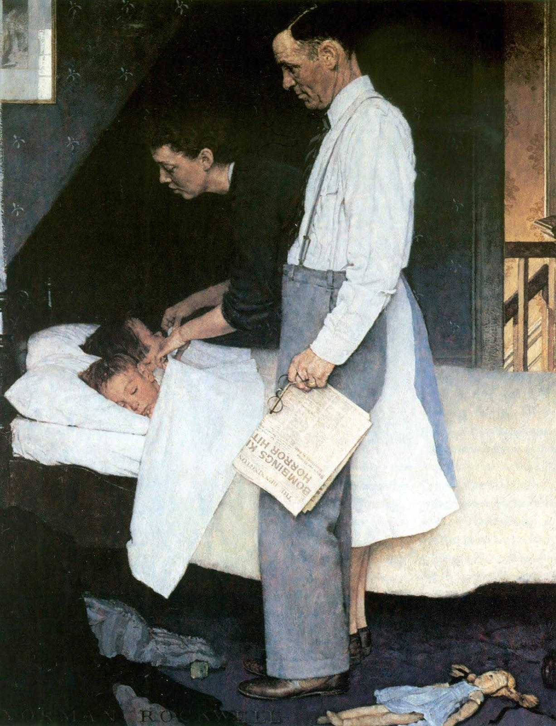
“
Messages are sent on a best effort basis. Nodes can leave and rejoin the network at will, accepting the longest proof-of-work chain as proof of what happened while they were gone.
~Satoshi Nakamoto
Norman Rockwell's Freedom from Fear 1943
Notes:
Talked about in Peace and Bitcoin: https://www.youtube.com/watch?v=Fn-SpMrTuyI
Norman Rockwell's Freedom from Fear

Slide 7
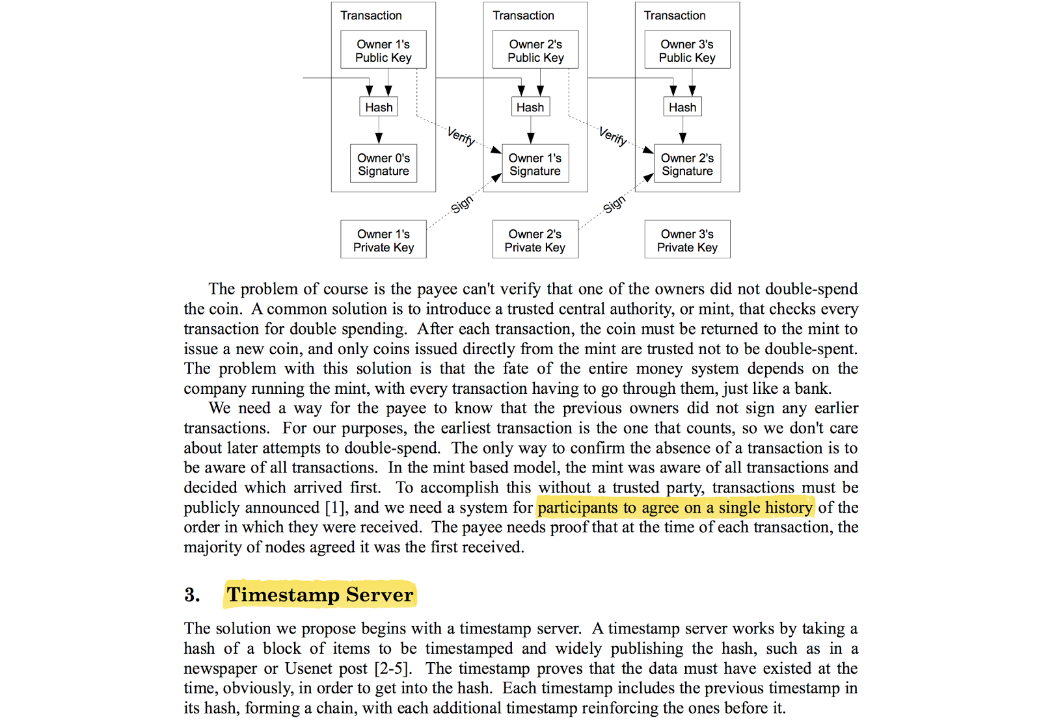

Slide 8
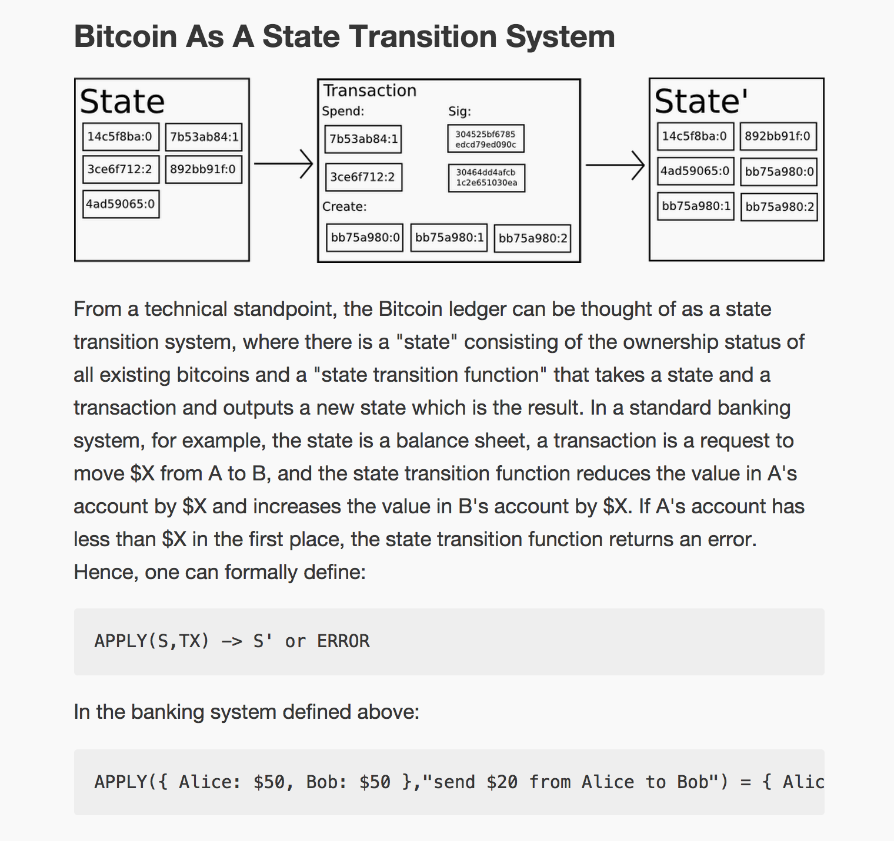
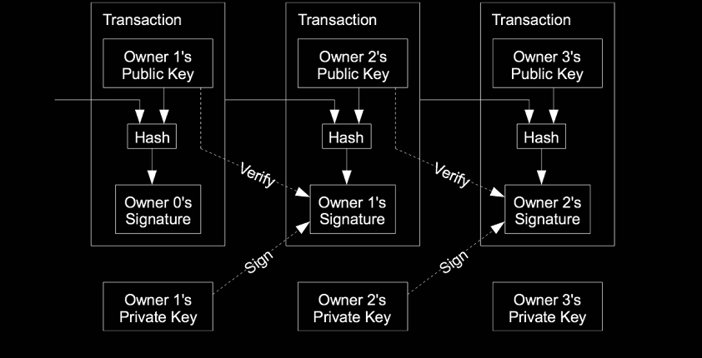
Notes:
Bitcoin is a distributed database with a state transition rule

Slide 9
Merkle Root
18e44f11e94a586c6f0a838ad92cb8b061b6f873e1c56635618bf84bca63eab7

Slide 10
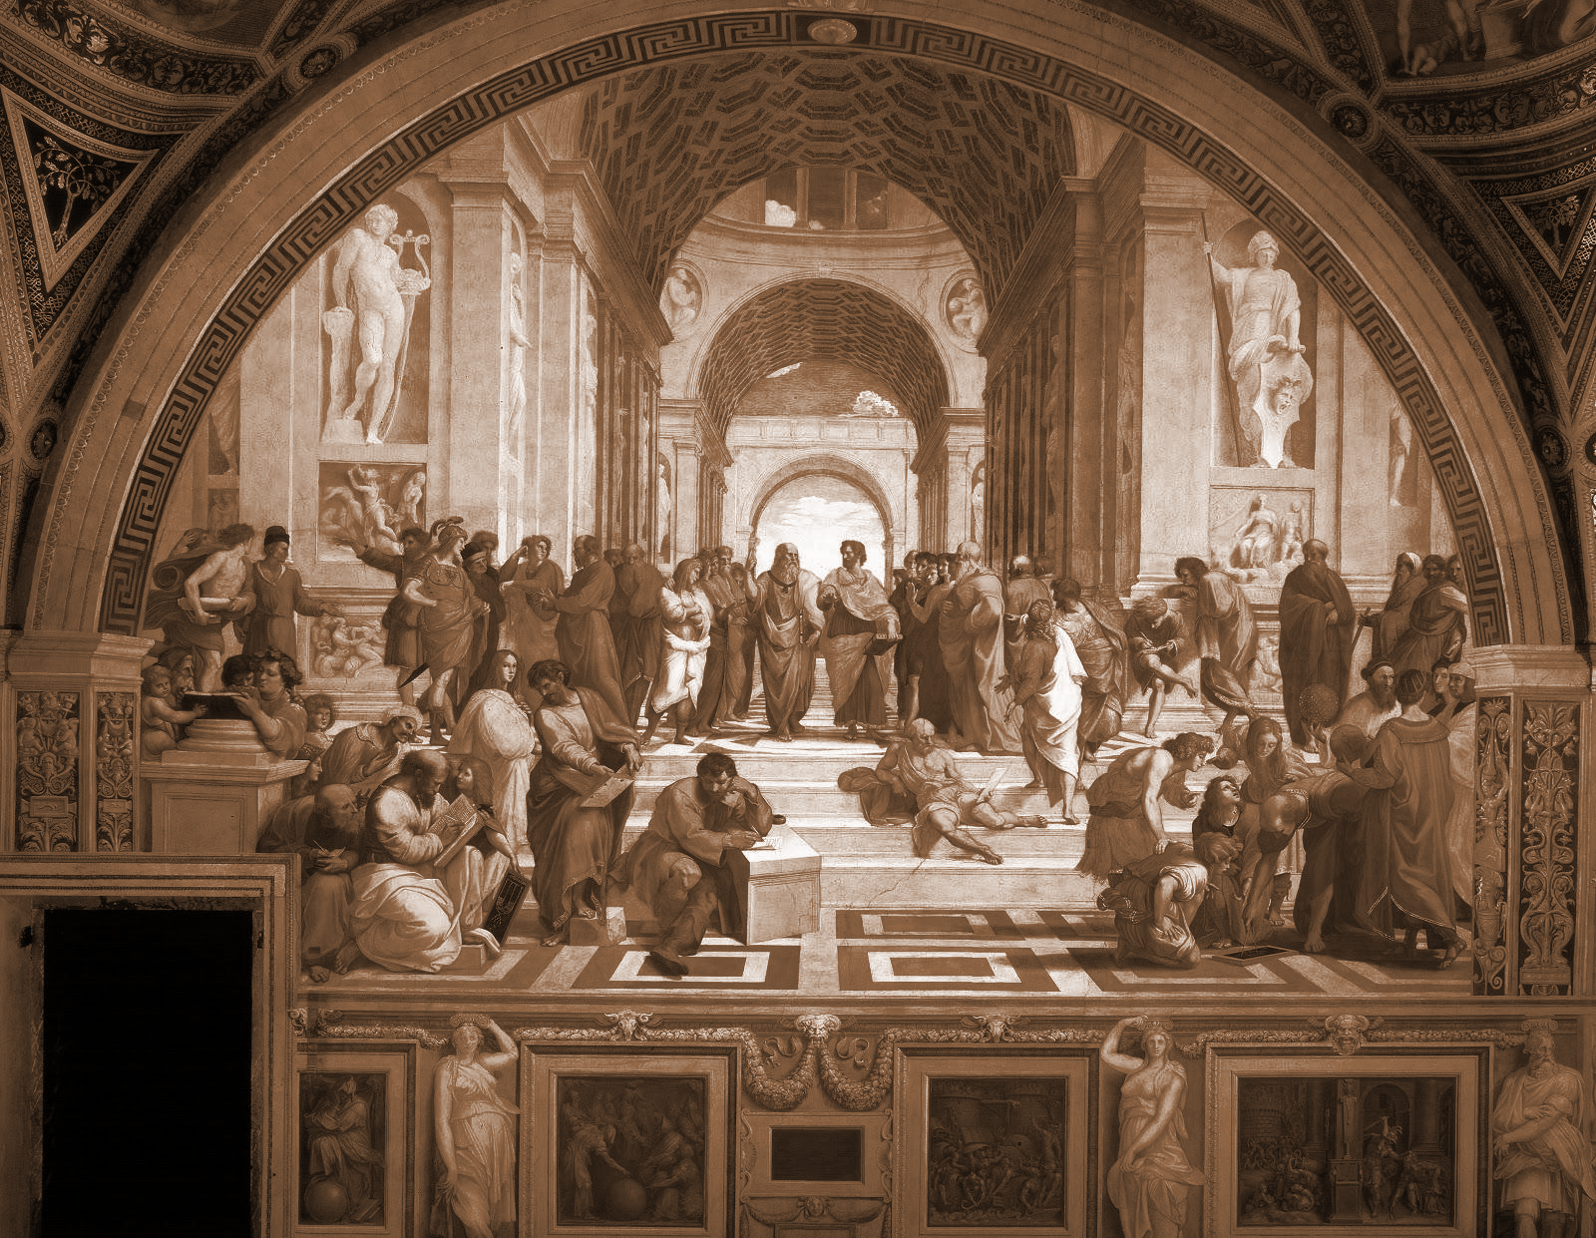
Basic Concepts
The sophos (the experts) & the demos (the people)
The episteme (knowledge) and the doxa (opinion)

Slide 11
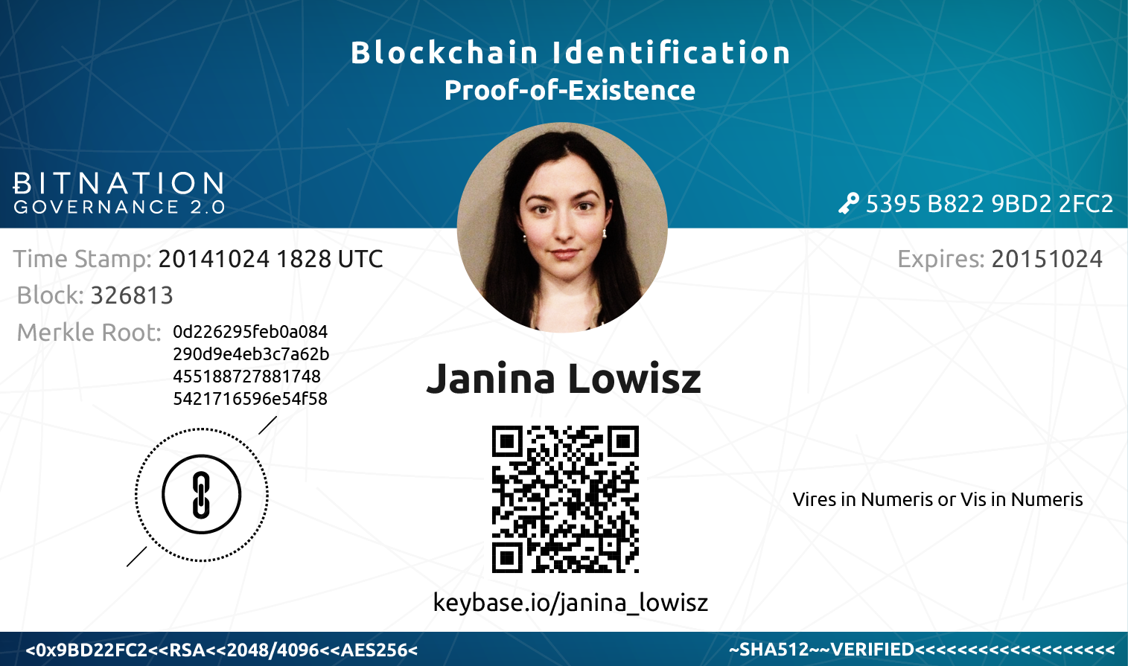
World Citizenship - A Case Study
Notes:
Talked about in Peace and Bitcoin: https://www.youtube.com/watch?v=Fn-SpMrTuyI
Norman Rockwell's Freedom from Fear

Slide 12
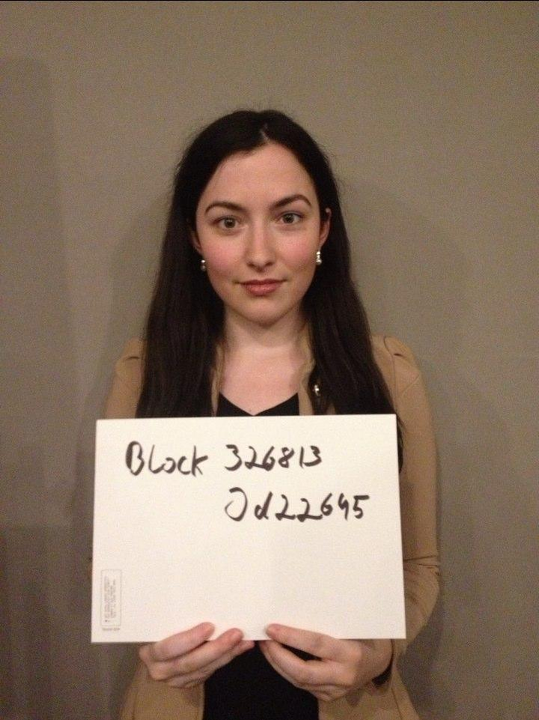

Slide 13
My Underlying Assumptions
Defining definition
To demarcate; to draw a border
A good definition should be succinct
Defining Entrepreneurialism
The ability to anticipate demand
Well performing entrepreneurship is recognised
One who meet the demands of others
De-risk uncertain environments
In order to help others achieve their goals
Defining Business
Defining Business
A sequence of activities
Defining Profit
Progress
Risk is distributed
In short: whose ideas get to be brought in to the material world?
Who gets the land, the money, the food, the security
The internet is an interconnected network
It networks networks

Slide 14
Thank-you for your time
Say ‘hi’ on Twitter @MrChrisEllis
Notes:
Talked about in Peace and Bitcoin: https://www.youtube.com/watch?v=Fn-SpMrTuyI
Norman Rockwell's Freedom from Fear

